Slide 1
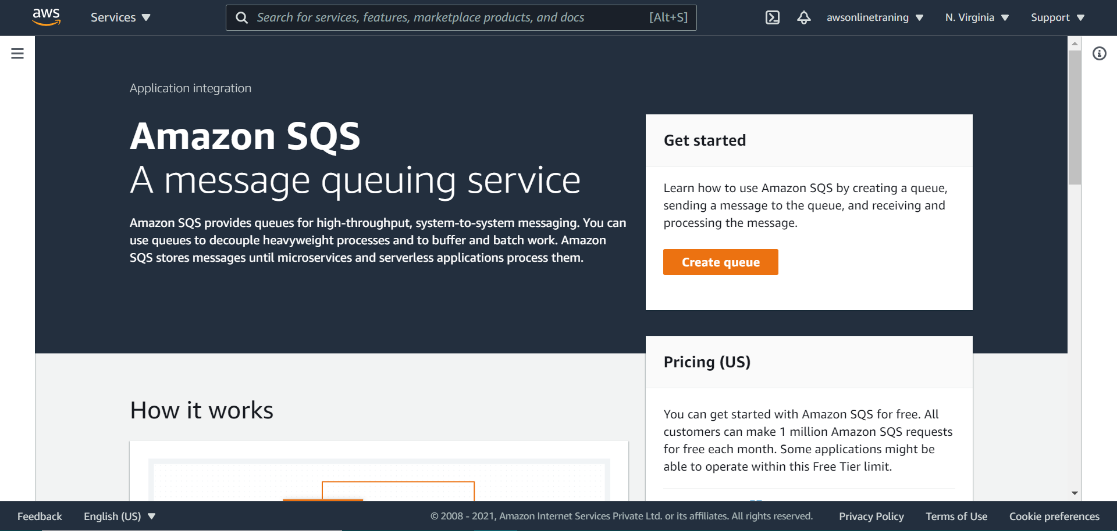

Slide 2
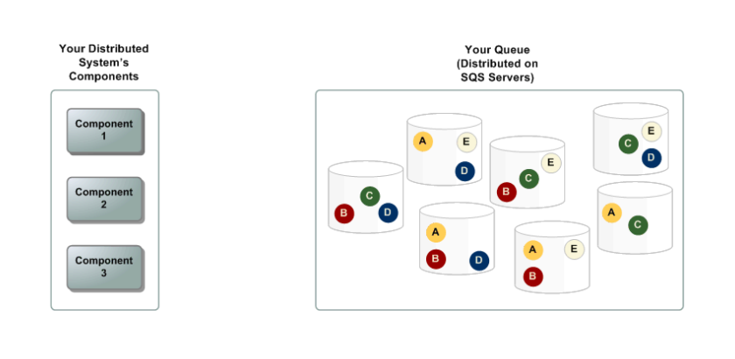

Slide 3
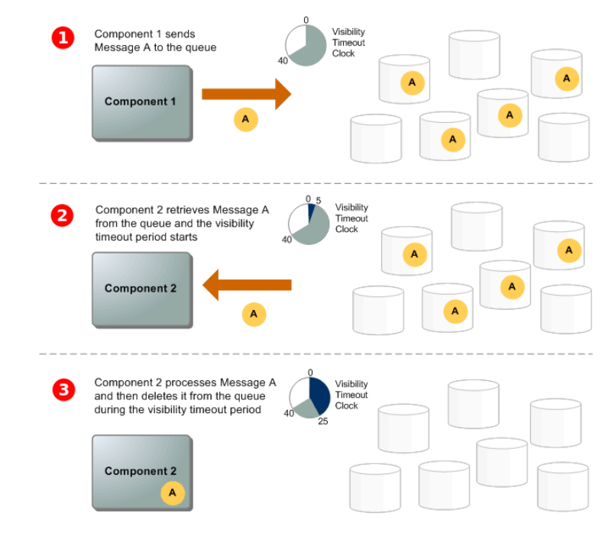

Slide 4
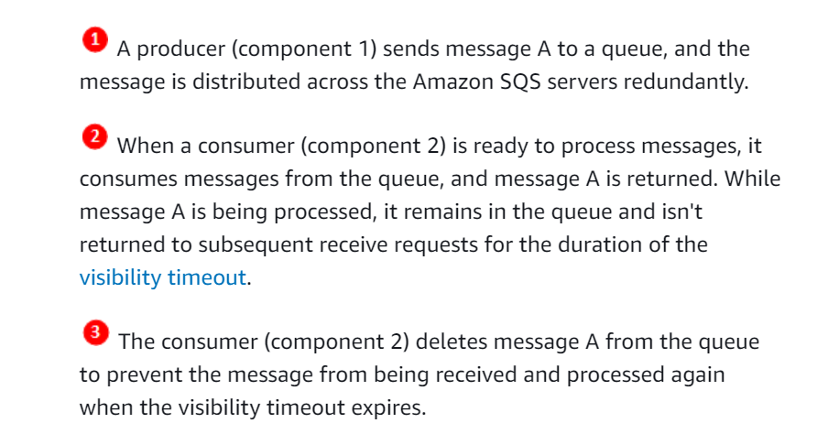

Slide 5
https://github.com/awsdocs/aws-doc-sdk-examples
Notes:
https://github.com/awsdocs/aws-doc-sdk-examples

